Slide 1
ShanghaiTech University
EE 115B: Digital Circuits
Fall 2021
Lecture 5
Hengzhao Yang
October 12, 2021

Slide 2

EE115 Analog and Digital Circuits
Topic 4: Logic Gates
Prof. Yajun Ha
ShanghaiTech University
Shanghai, China
This set of slides is by © Pearson Education

Slide 3

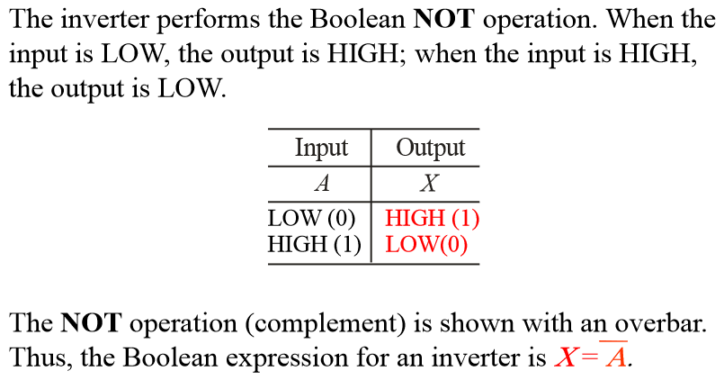
The Inverter (1)

Slide 4
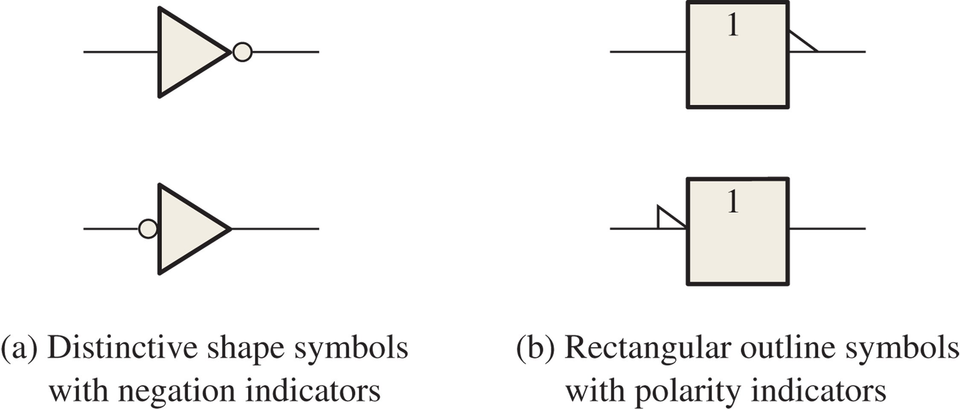
FIGURE 3-1 Standard logic symbols for the inverter (ANSI/IEEE Std. 91-1984/Std. 91a-1991).

Slide 5
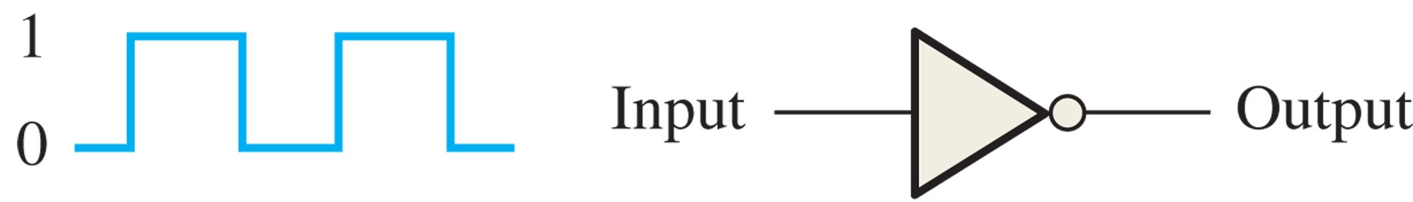
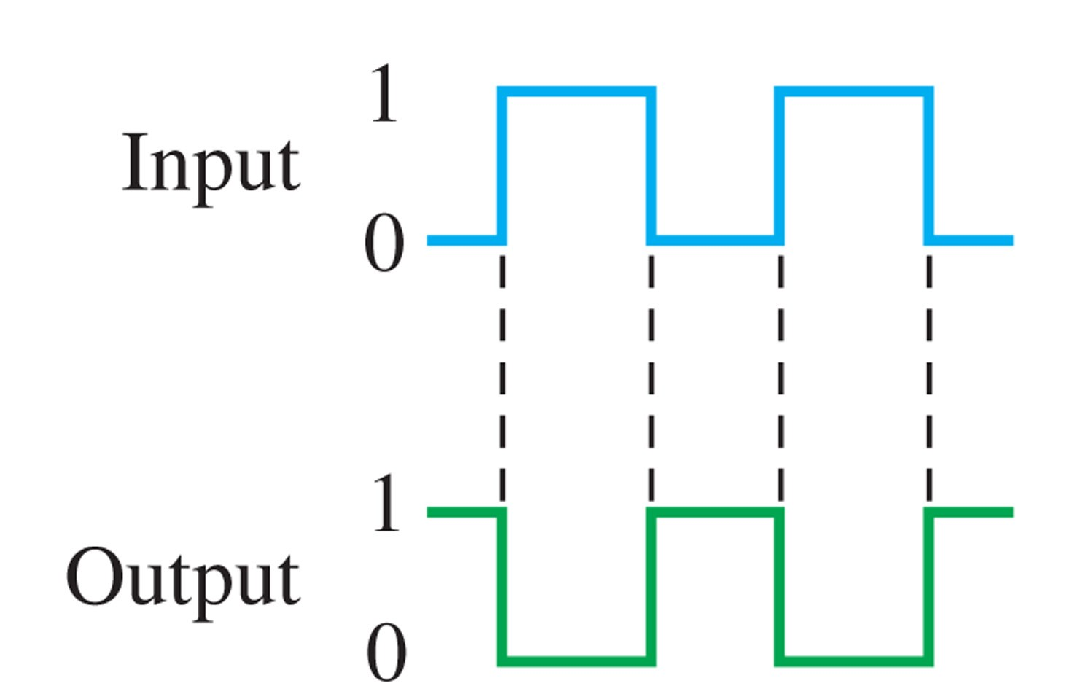
Example: Given the input, plot the output waveform.
Solution: See below for the timing diagram.

Slide 6

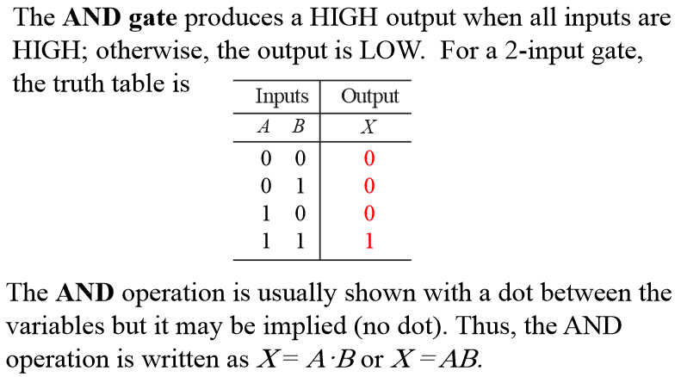
The AND Gate (1)
Prof. Yajun Ha
Notes:
Title

Slide 7
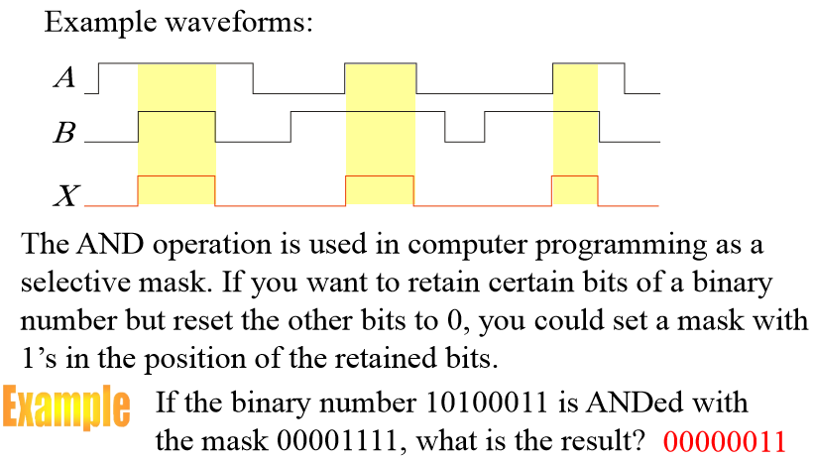
The AND Gate (3)

Slide 8

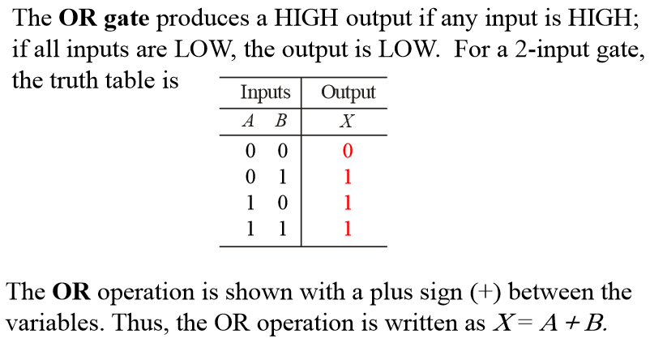
The OR Gate (1)
Prof. Yajun Ha
Notes:
Title

Slide 9
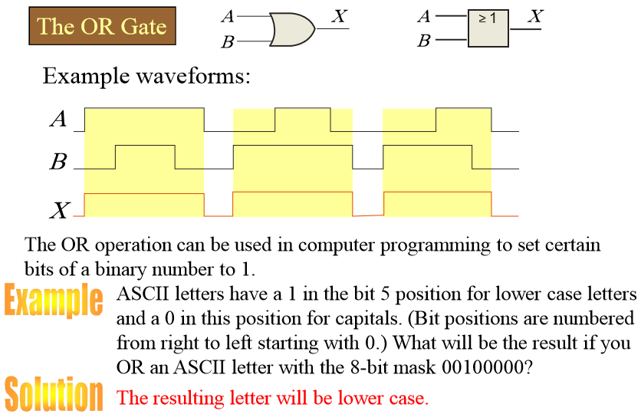
The OR Gate (2)
Prof. Yajun Ha
Notes:
Title

Slide 10

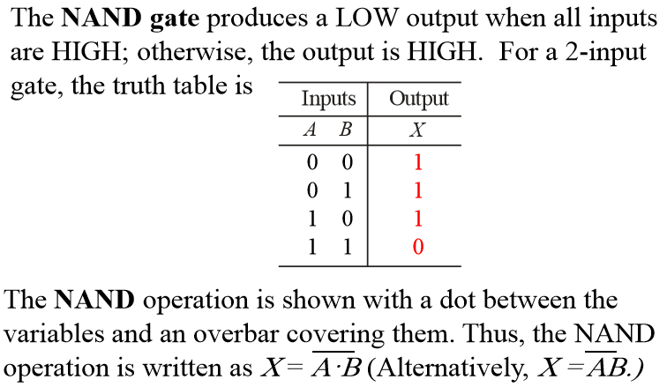
The NAND Gate (1)
Prof. Yajun Ha
Notes:
Title

Slide 11

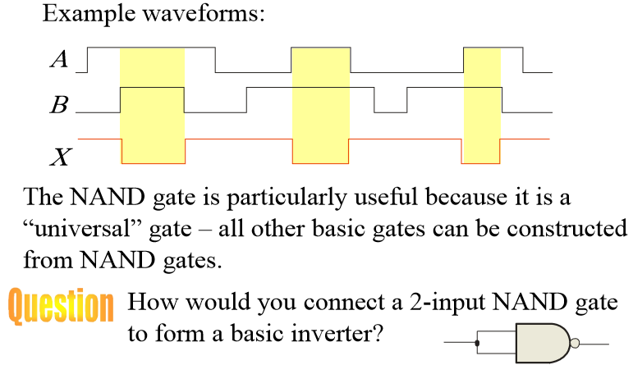
The NAND Gate (2)
Prof. Yajun Ha
Notes:
Title

Slide 12

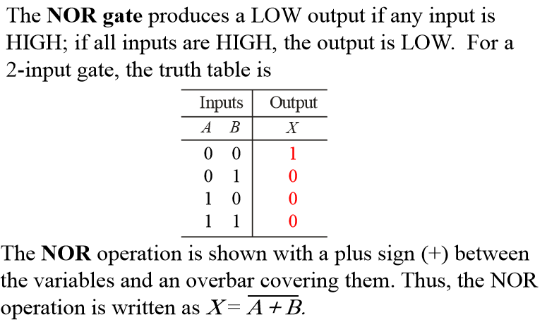
The NOR Gate (1)
Prof. Yajun Ha
Notes:
Title

Slide 13

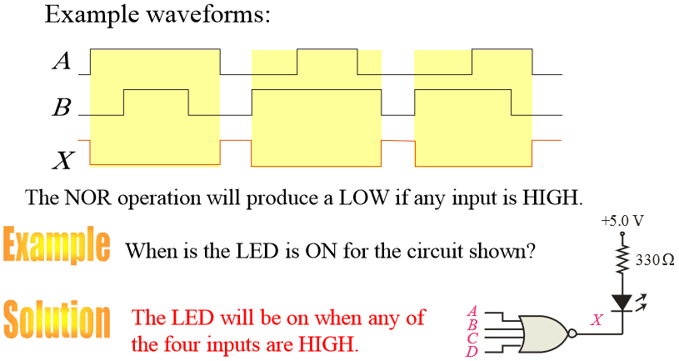
The NOR Gate (2)
Prof. Yajun Ha
Notes:
Title

Slide 14

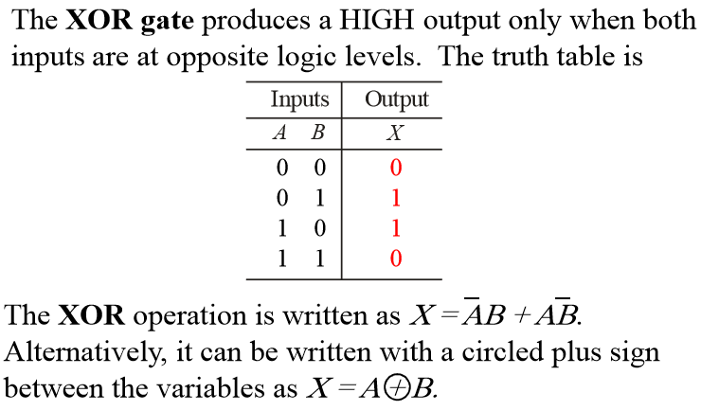
The XOR Gate (1)
Prof. Yajun Ha
Notes:
Title

Slide 15
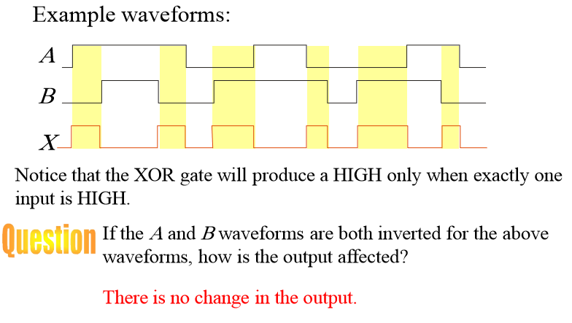
The XOR Gate (2)
Prof. Yajun Ha
Notes:
Title

Slide 16

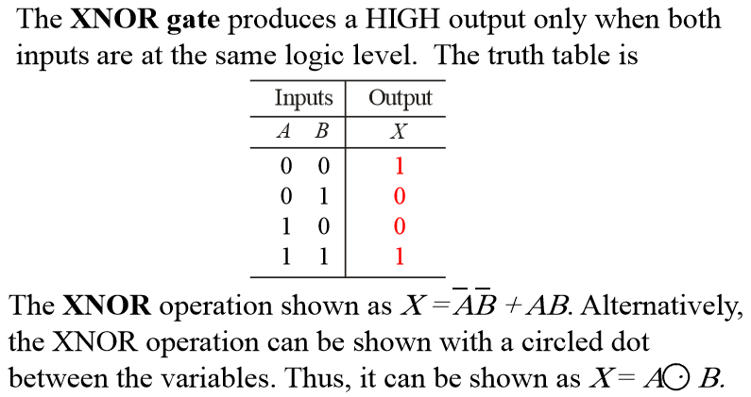
The XNOR Gate (1)
Prof. Yajun Ha
Notes:
Title

Slide 17
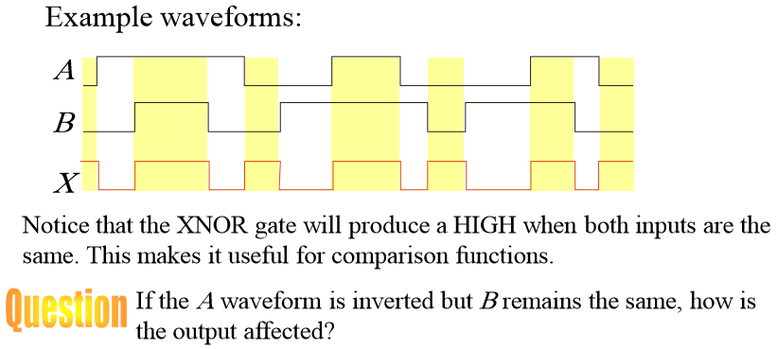

The XNOR Gate (2)
Prof. Yajun Ha
Notes:
Title

